Slide 1
Variables, Functions, Objects
JavaScript
CS275 - JavaScript

Slide 2
Working with Variables, Functions, and Objects
  How to declare and use variables
  How to define and call functions
  About built-in JavaScript functions
  How to use JavaScript objects
  How to use object inheritance and prototypes
  How to use object methods
  About built-in JavaScript objects
  About variable scope
CS275 - JavaScript

Slide 3
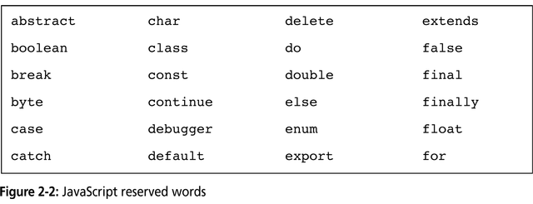
Working with Variables, Functions, and Objects
Variables (or identifiers)
  Values stored in computer memory locations
  Value can vary over time
  Cannot use reserved words as variables
    Reserved Words or Keywords are part of the JavaScript language syntax
  Variable Example:
    employeeName
CS275 - JavaScript

Slide 4
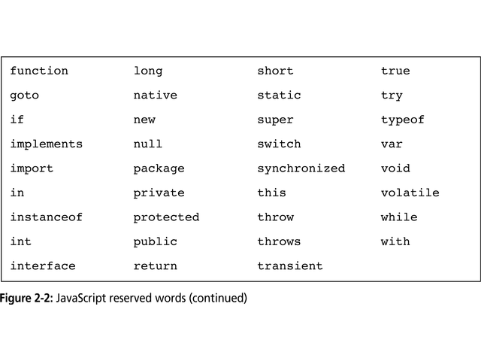
CS275 - JavaScript

Slide 5
Working with Variables, Functions, and Objects
Variables
  To create:
    Use keyword var to declare the variable
    Use the assignment operator to assign the variable a value
  Declare, then assign value (initialize)
    var employeeName;
    employeeName = “Ric”;
  Declare and assign variable in a single statement
    var employeeName = “Ric”;
  Once created:
    May be changed at any point in the program
  Use variable name and assignment operator
    employeeName = “Althea”;
CS275 - JavaScript

Slide 6
Working with Variables, Functions, and Objects
Variables
  Syntax rules
    Like C/C++ identifiers!!!
    Cannot use:
      Reserved words & spaces
    Must begin with one of the following:
      Uppercase or lowercase ASCII letter
      Dollar sign ($) or underscore (_)
    Can use numbers, but not as first character
    Variables are case-sensitive
  Conventions
    Use underscore or capitalization to separate words of an identifier
      employee_first_name
      employeeFirstName
CS275 - JavaScript

Slide 7
Working with Variables, Functions, and Objects
Defining Custom Functions
  Function:
    Individual statements grouped together to form a specific procedure
    Allows you to treat the group of statements as a single unit
    Must be contained between <script> and </script> tags
    Must be formally composed (function definition)
  A function definition consists of three parts:
    Reserved word function followed by the function name (identifier)
    Parameters required by the function, contained within parentheses following the name
      Parameters → variables used within the function
      Zero or more may be used
    Function statements, delimited by curly braces { }
CS275 - JavaScript

Slide 8
Working with Variables, Functions, and Objects
Calling Functions
  Function invocation or call
    Statement including function name followed by a list of arguments in parentheses
    Parameter of function definition takes on value of argument passed to function in function call
  Code placement
    Functions must be created (defined) before called
      <head> rendered by browser before <body>
    Function definition
      Place in <head> section
    Function call
      Place in <body> section
Returning a value from a Function
  A function can return nothing
    Just performing some task
  A function can return a value
    Perform a calculation and return the result
      Var returnValue = functionCall(opOne, opTwo);
    A return statement must be added to function definition
CS275 - JavaScript

Slide 9
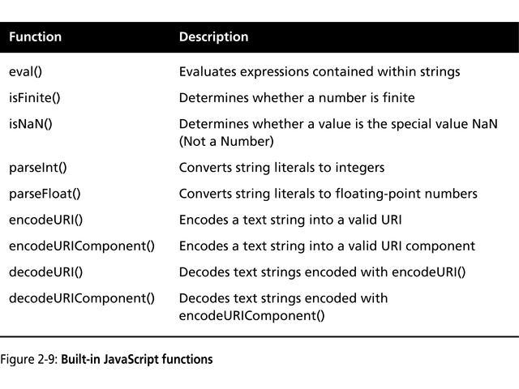
Working with Variables, Functions, and Objects
Built-in JavaScript Functions
  Functions defined as part of the JavaScript language
  Function call identical to the custom functions
CS275 - JavaScript

Slide 10
Working with Variables, Functions, and Objects
Understanding JavaScript Objects
  In OO languages (Java, C++)
    Class structures contain associated variables, methods (functions) and statements
    Objects are instances of classes
      (i.e., objects are instantiated from classes)
    Classes can be inherited from other classes
  JavaScript is not truly object-oriented
    Cannot create classes
  Custom JavaScript objects
    Based on constructor functions
      Instantiate a new object or extending an old object
      Objects inherit all variables and statements of constructor function
    Any JavaScript function can serve as a constructor
  Constructor function
    Has two types of elements
      Property (field)
        Variable within a constructor function
        Data of the object
      Method
        Function called from within an object
        Can be custom or built-in function
CS275 - JavaScript

Slide 11
Working with Variables, Functions, and Objects
Understanding JavaScript Objects
  Constructor function
    Identifier naming convention
      First word uppercase to differentiate from non-constructor functions
        BankEmployee
    The this keyword
      Used in constructor functions to refer to the current object that called the constructor function
    The new keyword
      Used to create new objects from constructor functions
      Example:
        Billy = new BankEmployee(name, empNum);
CS275 - JavaScript

Slide 12
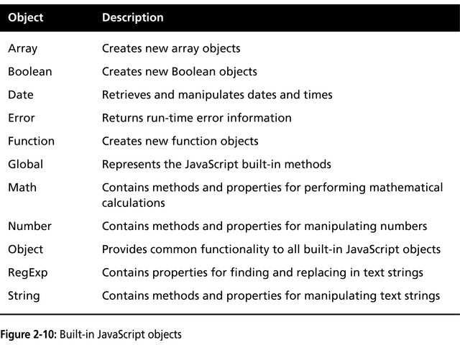
Working with Variables, Functions, and Objects
Understanding JavaScript Objects
  Built-in JavaScript objects
    JavaScript includes 11 built-in objects
    Each object contains various methods and properties for performing a particular task
    Can be used directly in program without instantiating a new object
CS275 - JavaScript

Slide 13
Working with Variables, Functions, and Objects
Understanding JavaScript Objects
  Custom object inheritance and prototypes
    Objects inherit the properties and methods of their constructor function
    Constructor functions:
      Do not require parameters
      Do not require passed arguments
        Properties may set the value at a later time
        If used before set, will return an undefined value
    Adding properties after object is instantiated
      Properties can be added to objects using dot operator (.)
      These properties available only to that specific object
    Prototype properties
      Properties added using prototype keyword
      Available to all objects that extend the constructor function
        BankEmployee.prototype.department = “”;
    Object definitions can extend other object definitions
      Extend original definition and add new properties or function calls
CS275 - JavaScript

Slide 14
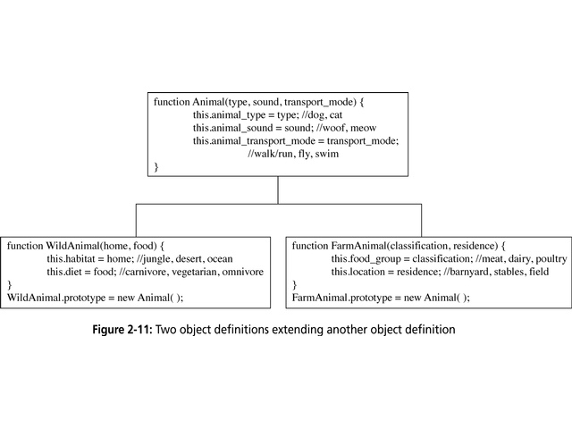
CS275 - JavaScript

Slide 15
Working with Variables, Functions, and Objects
Understanding JavaScript Objects
  Custom object methods
    Functions associated with a particular object
      Define the function
      Use the this reference to refer to object properties
      Add it to the constructor function
        this.methodName = functionName
    Call the method using the dot operator (.)
Variable Scope
  Defines where in the program a declared variable can be used
    Global variable
      Declared outside a function and is available to all parts of the program
      var keyword optional
    Local variable
      Declared inside a function and is only available within the function it is declared
    Global and local variables can use same identifier
CS275 - JavaScript

